Slide 1
Learning

Slide 2
Learning
Learning is the process of acquiring new understanding, knowledge, behaviors, skills, values, attitudes, and preferences.
The ability to learn is possessed by humans, animals, and some machines.

Slide 3
Learning
Learning is “a process that leads to change, which occurs as a result of experience and increases the potential for improved performance and future learning”
The change in the learner may happen at the level of knowledge, attitude or behavior.

Slide 4
Learning
Learning includes----
Knowledge
Experience
Change
Improvement

Slide 5
5 principles of learning
Participation
Repetition
Relevance
Transference
Feedback

Slide 6
Motivation, learning and performance

Slide 7
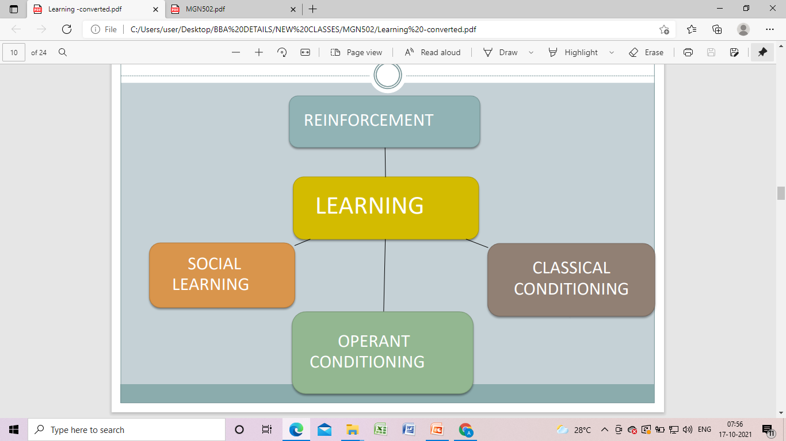
Theories

Slide 8
Classical conditioning theory
Classical conditioning is a behaviorist theory of learning developed by Ivon Pavlov.
It posits that when a naturally occurring stimulus and an environmental stimulus are repeatedly paired, the environmental stimulus will eventually elicit a similar response to the natural stimulus.

Slide 9
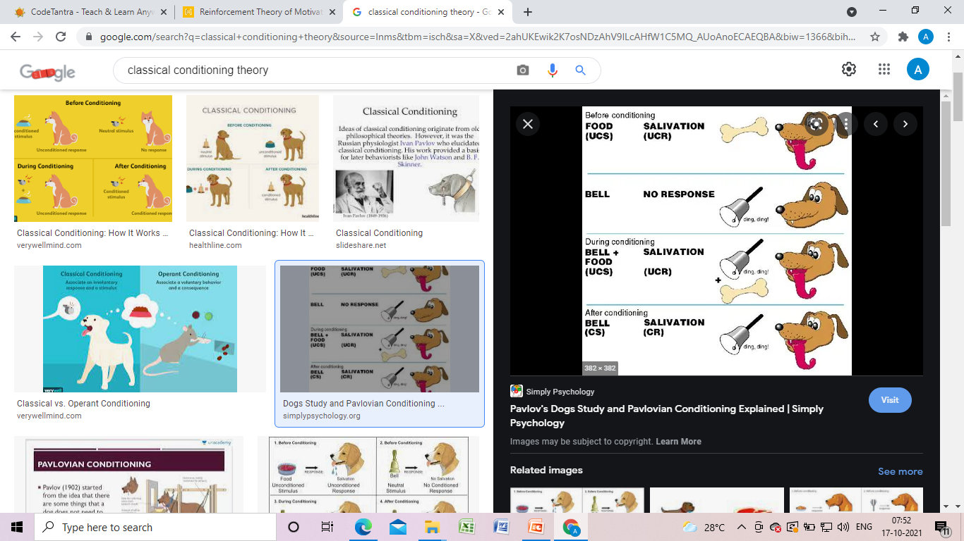
Classical conditioning theory

Slide 10
Operant conditioning theory
Operant conditioning is a type of associative learning process through which the strength of a behavior is modified by reinforcement or punishment.
It is also a procedure that is used to bring about such learning

Slide 11
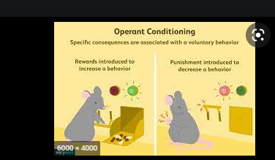
Operant conditioning theory

Slide 12
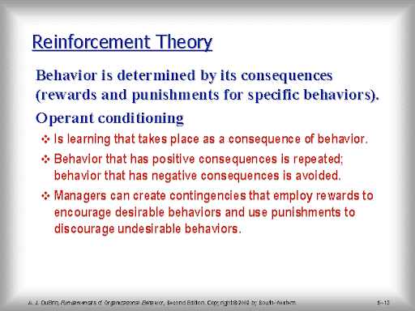

Slide 13
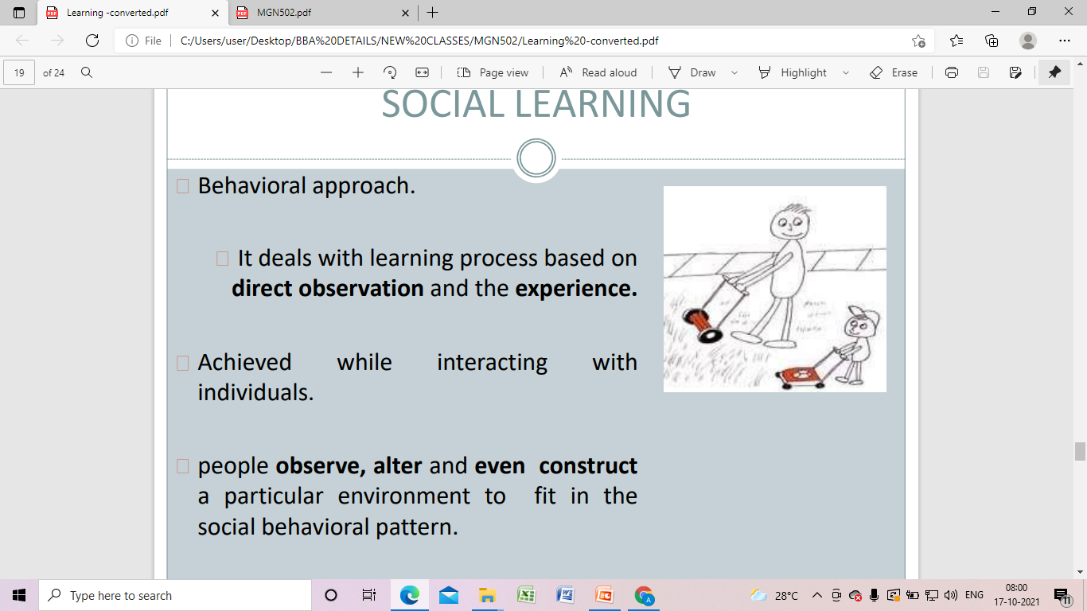

Slide 14
Reinforcement theory
Reinforcement theory is a limited effects media model applicable within the realm of communication.
The theory generally states that people seek out and remember information that provides cognitive support for their pre-existing attitudes and beliefs

Slide 15
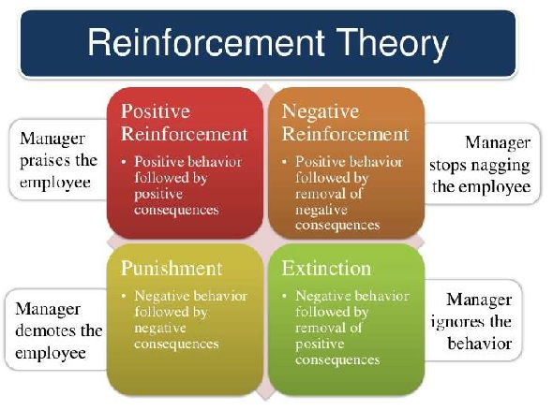

Slide 16
Learning organization
????

